Slide 1
Secure Data Hiding in images using steganography
CAPSTONE PROJECT
Presented By: Rutuja Jangam
Student Name : Rutuja Jangam
College Name & Department : Modern College Of Arts, Science And Commerce Ganeshkhind Pune (dept-Mathematics)

Slide 2
OUTLINE
Problem Statement
Technology used
Wow factor
End users
Result
Conclusion
Git-hub Link
Future scope

Slide 3
Problem Statement
Secure data hiding in images using steganography is focuses on concealing sensitive information within digital images to ensure confidentiality and security.
It utilizes steganography techniques like LSB substitution.
The project aims to enhance data security while maintaining imperceptibility to unauthorized users.

Slide 4
Technology used
Python version 3.13
Jupyter Notebook
PIL- The pillow library (formerly know as PIL-Python Imaging Library) is powerful tool for working with images in python.
It allows you to open ,manipulate and save different image formats.

Slide 5
Wow factors
Invisible yet secure-The hidden data does not alter the images appearance.
Dual-purpose images- The same image can serve as both a regular visual file and a secret data carrier.
Resistant to unauthorized detection
Real-World Applications-Used in secure communication, watermarking and digital forensics to protect sensitive information.

Slide 6
End users
Government and defence Agencies- For secure and covert communication.
Journalist and Activists- To protect sensitive information from surveillance.
Cybersecurity Professionals- For secure data transmission and digital watermarking.
Individuals and Businesses- To safeguard confidential documents and communication.
Digital Forensics experts- For detecting hidden messages in cybercrime investigations.

Slide 7
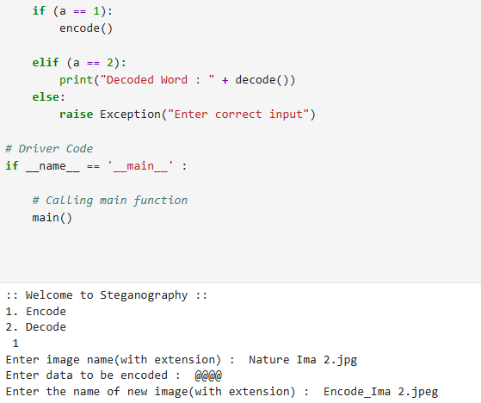
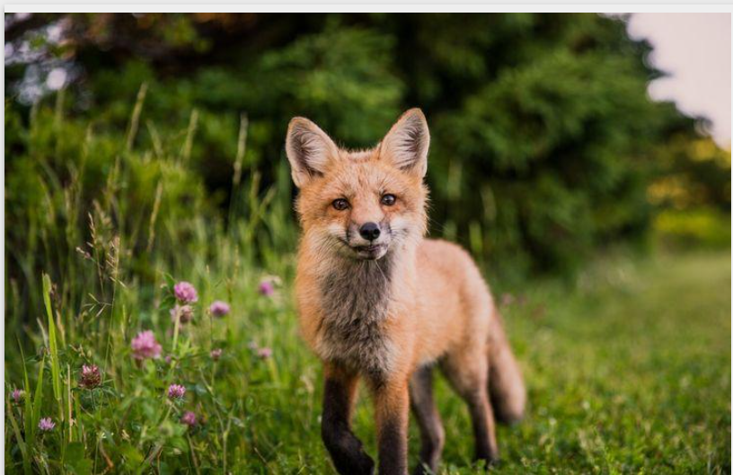
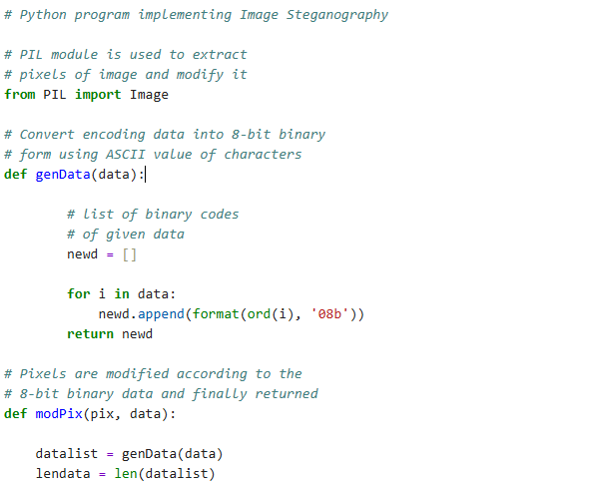
Results

Slide 8
Conclusion
This project successfully demonstrates the effectiveness of steganography in securely embedding data within images while maintaining their visual integrity by utilizing techniques like least significant bit(LSB) substitution .
It ensure confidential communication and data protection against unauthorized access.

Slide 9
GitHub Link
https://github.com/Rutu09j/Cyber-Security.git

Slide 10
Future scope(optional)
Enhanced security with encryption
AI-powered steganography
Support for multiple media types.
Cloud based steganography
Steganalysis resistance
Real-time secure communication
Blockchain integration.

Slide 11
THANK YOU

